Slide 1

MYLEGION: MBR MANAGEMENT
Manage SAL membership. View, edit, print membership card, assign group permission, and email a single member or group of members.
2026
Notes:
MyLegion is a secure website for American Legion and Sons of the American Legion members. View and manage membership information through MyLegion.org.

Slide 2
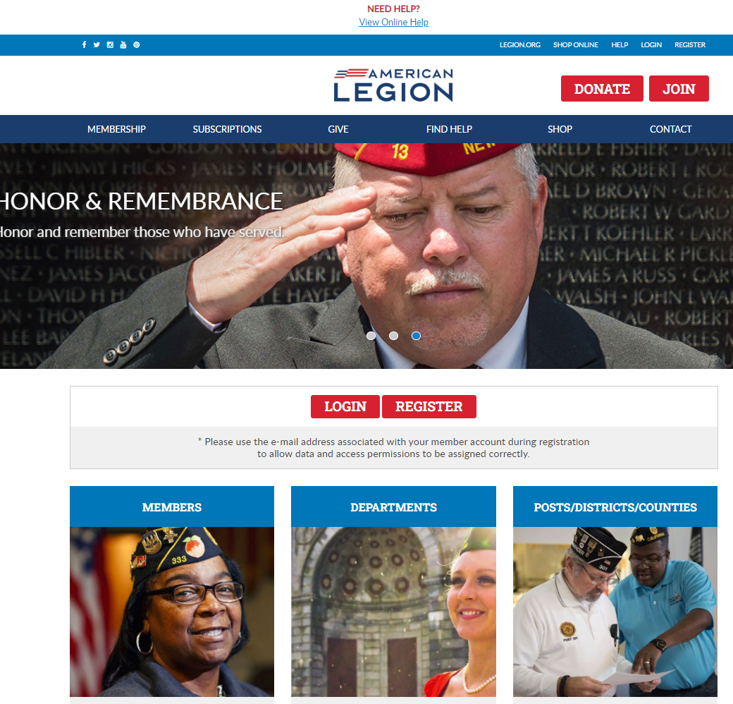

Log in or register a myLegion account to view and manage membership.
Notes:
Administrative membership management tools are available through MyLegion. Begin by logging into MyLegion and proceed to the My Groups menu.

Slide 3
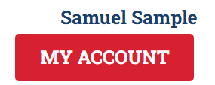
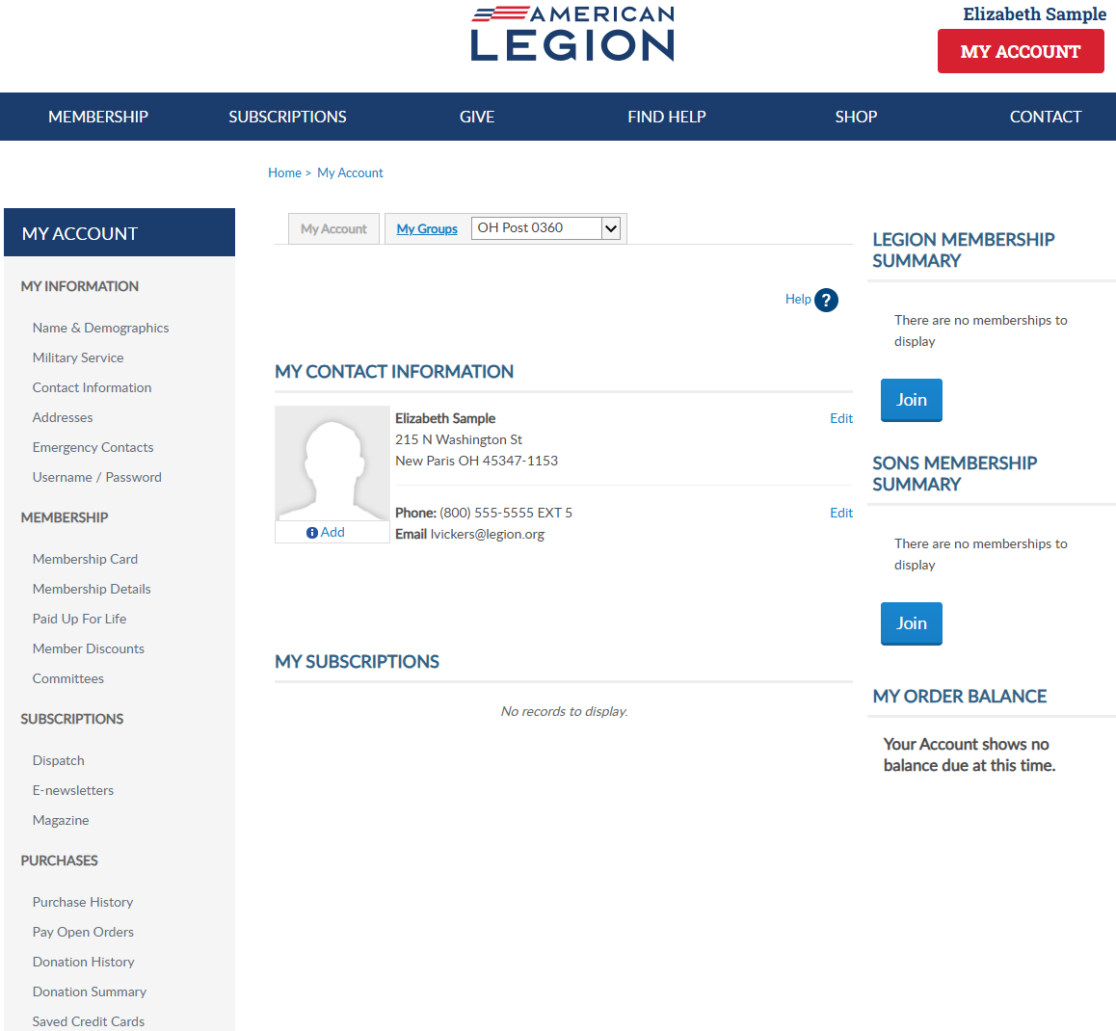

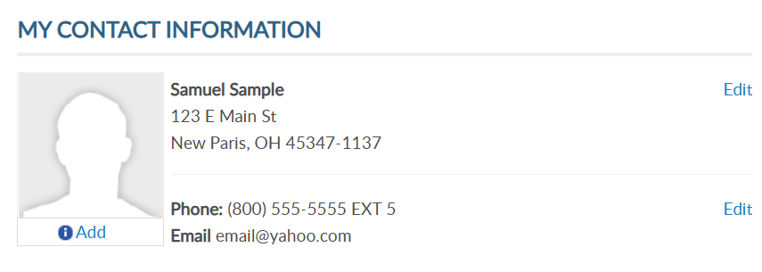
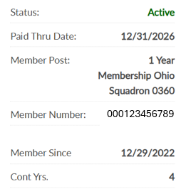
Adjutants, commanders and assigned admins will have a MyGroups menu.
MYLEGION.ORG
No group menu? Contact your department headquarters.
Notes:
My Groups is the administrative side of myLegion available to adjutants and commanders and assigned administrators. <1> If you do not have a My Groups menu and are a current adjutant or commander, contact your department headquarters.

Slide 4
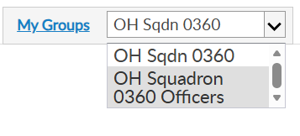
MY GROUPS
Adjutants and Commanders
Post, Squadron, District, County, Dept, Detach
Legion has LGN and SAL
Officer Groups: view only
Select group to transition to the admin side of myLegion.
Notes:
Legion leadership have access to both legion and Sons of the American Legion groups. Officer groups are view only. All officers are reported through department headquarters.
This member is a squadron adjutant. Post adjutants and commanders have access to both post and squadron membership and officer groups.
<1> Clicking on the group will navigate you to the administrative side of MyLegion, group profile.

Slide 5
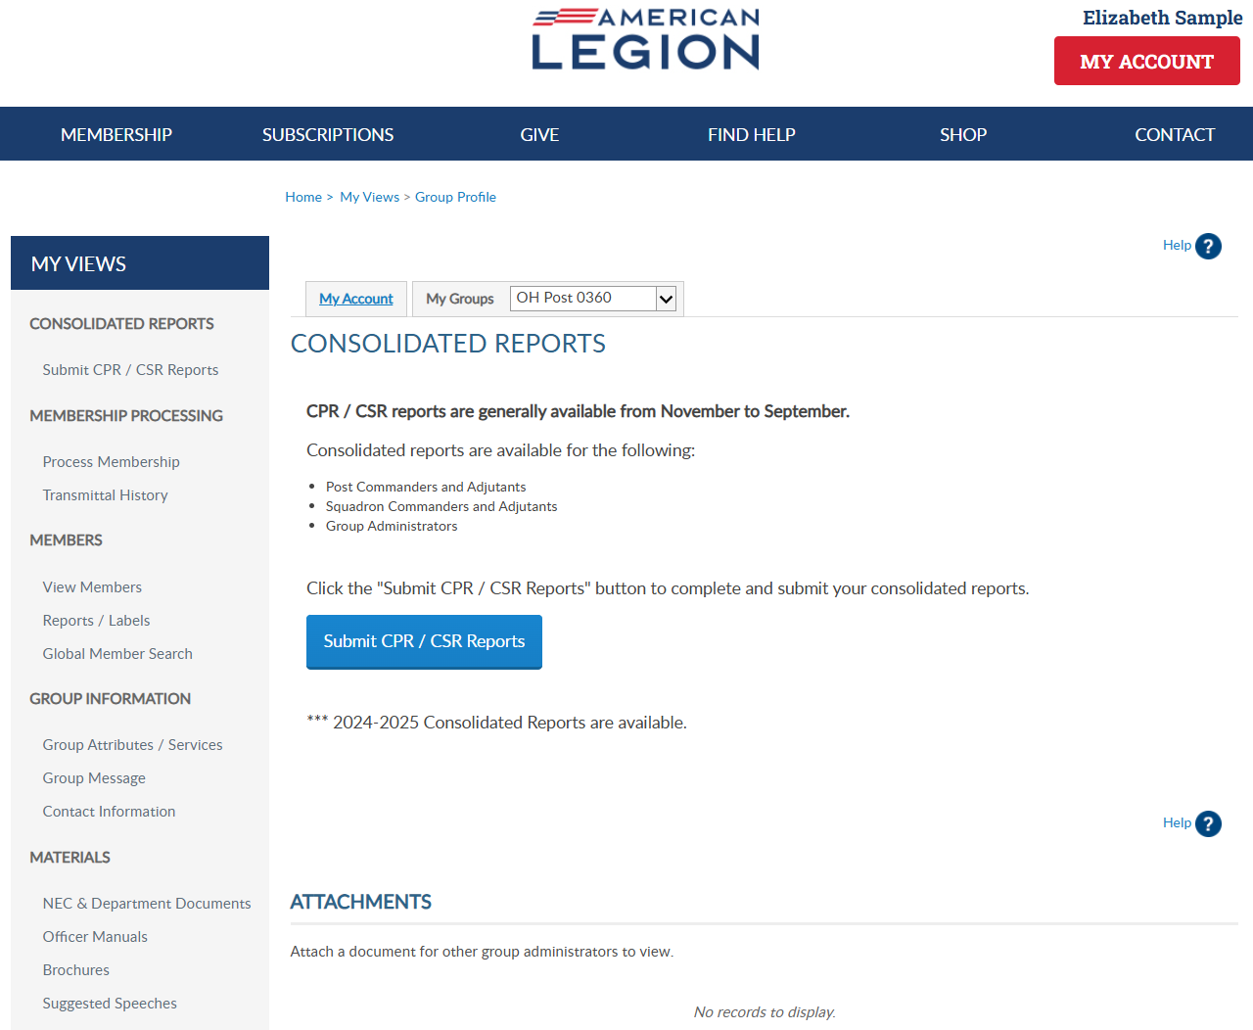
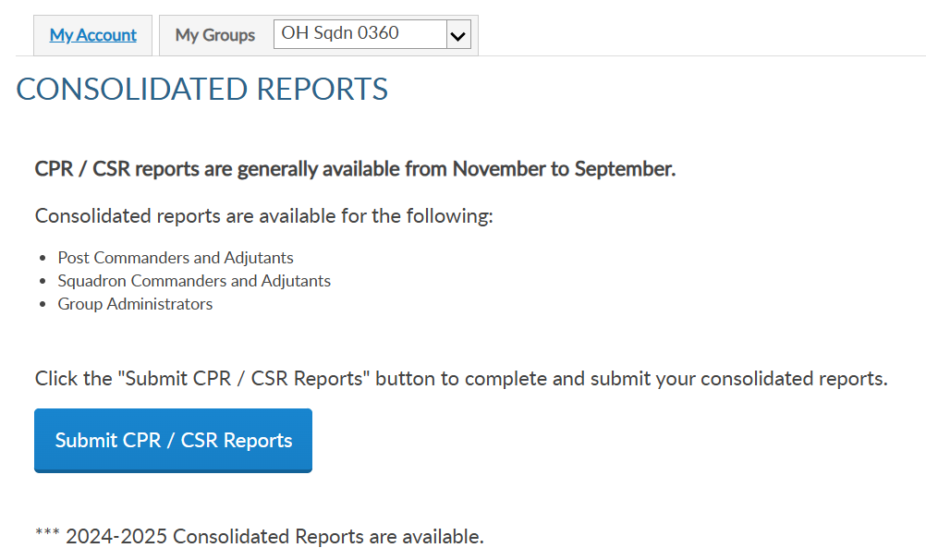
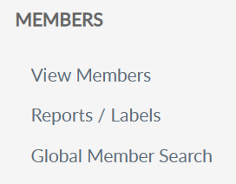
Notes:
View and manage member information using “View Members”. View Members takes you to the current membership list.

Slide 6
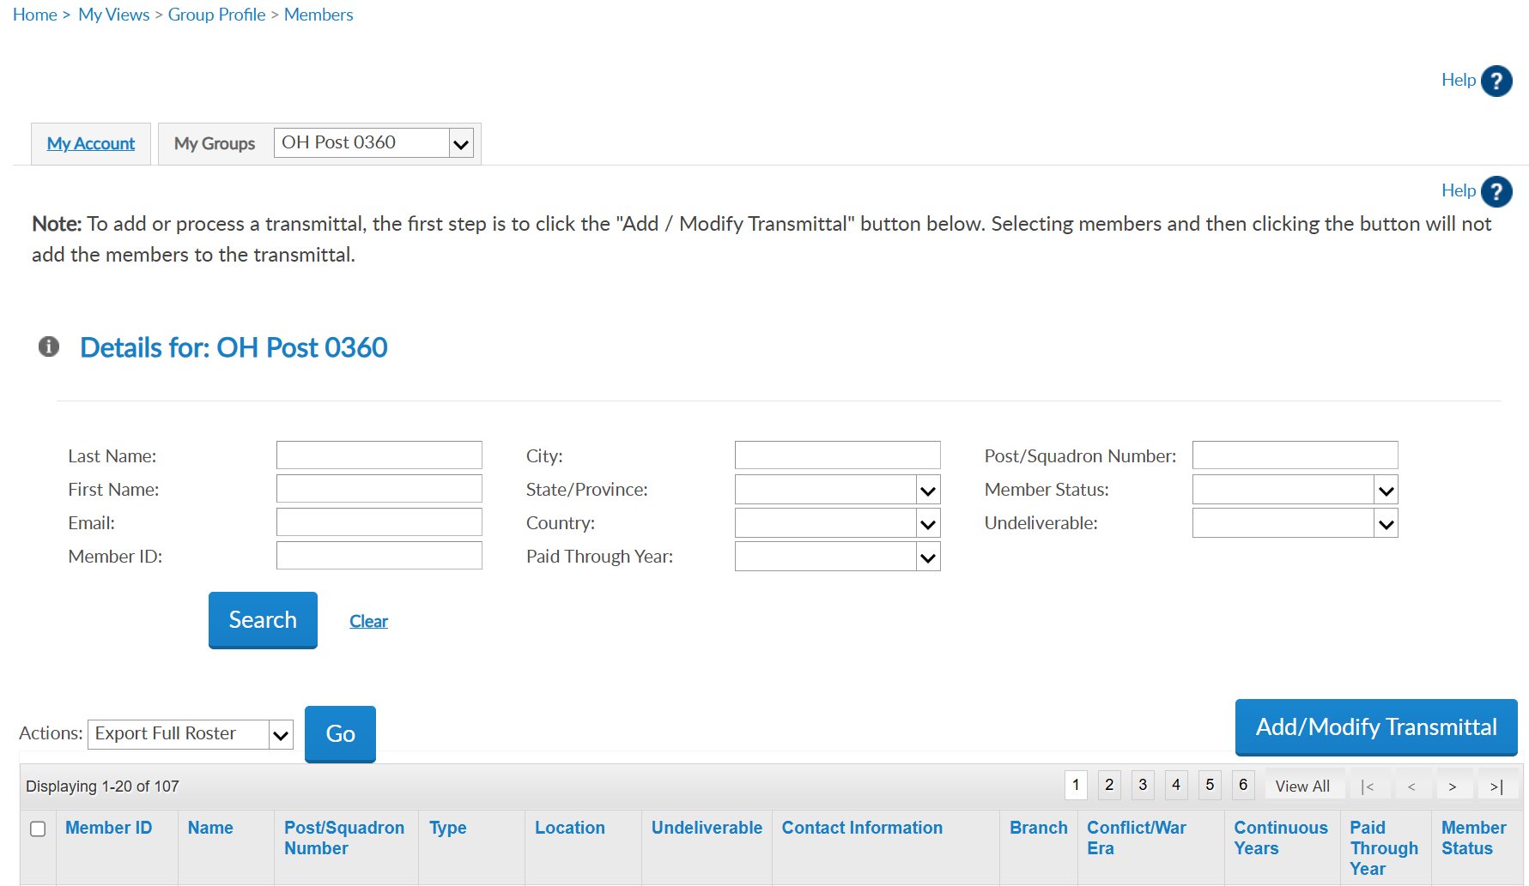



Do not use this area for reports. Use view members for a quick view of member info, member maintenance, and email communications.
Member ID | Last, First | Sons of American Legion OH Squadron 0360 | 1 Year Mbrship | Address |  | email address Phone | UNKNOWN | UNKNOWN | 5 | 2025 | Expired
Member ID | Last, First | Sons of American Legion OH Squadron 0360 | 1 Year Mbrship | Address |  | Phone |  |  | 49 | 2026 | Active
Member ID | Last, First | Sons of American Legion OH Squadron 0360 | 1 Year Mbrship | Address |  | email address Phone | USA | OTHER | 20 | 2026 | Active
102222456
Notes:
View members display current, expired and deceased members. It does not include members who have transferred out. Search filters allow you to find a specific member or group of members. Only one paid year will show.
<1> Do not use this area for reports. Use view members for a quick view or member info, maintenance, and email communications.

Slide 7
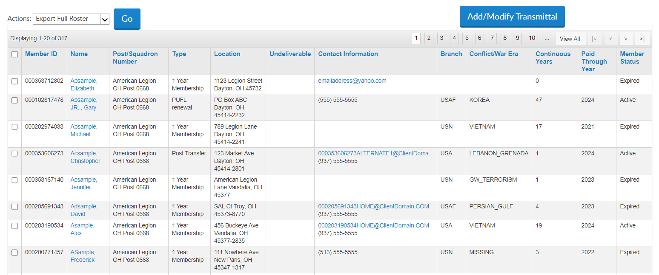
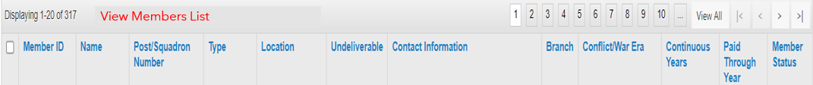
Click on label to sort list and navigate page to page.
View Members List
Member ID | Last, First | Sons of American Legion OH Squadron 0360 | 1 Year Mbrship | Address |  | email address Phone | UNKNOWN | UNKNOWN | 5 | 2025 | Expired
Member ID | Last, First | Sons of American Legion OH Squadron 0360 | 1 Year Mbrship | Address |  | Phone |  |  | 49 | 2026 | Active
Member ID | Last, First | Sons of American Legion OH Squadron 0360 | 1 Year Mbrship | Address |  | email address Phone | USA | OTHER | 20 | 2026 | Active
Member ID | Last, First | Sons of American Legion OH Squadron 0360 | 1 Year Mbrship | Address | Y |  |  |  | 1 | 2026 | Active
Member ID | Last, First | Sons of American Legion OH Squadron 0360 | 1 Year Mbrship | Address |  | email address |  |  | 0 | 2026 | Expired
Member ID | Last, First | Sons of American Legion OH Squadron 0360 | 1 Year Mbrship | Address |  | email address Phone | USMC | GW_TERRORISM | 1 | 2026 | Active
Member ID | Last, First | Sons of American Legion OH Squadron 0360 | 1 Year Mbrship | Address |  | email address |  |  | 1 | 2025 | Expired
Member ID | Last, First | Sons of American Legion OH Squadron 0360 | 1 Year Mbrship | Address |  |  |  |  | 42 | 2026 | Active
Notes:
The data table provides member information including member ID, contact information, demographics, last paid year and status.
The view members list is alphabetical. Click on any of the title columns and navigation icons to sort and go from page to page.

Slide 8
New Members: Payment Pending
View Members List
123456781 | AaExample, James | American Legion OH Post 0360 | 1 Year Mbrship | Address |  | email address Phone | USAF | VIETNAM | 5 | 2025 | Expired
123456782 | AaExample, Jr, Fred | American Legion OH Post 0360 | PUFL renewal | Address |  | Phone | USAF | KOREA | 49 | 2026 | Active
123456783 | AaSample, Allen | American Legion OH Post 0360 | 1 Year Mbrship | Address |  | email address Phone | USA | VIETNAM | 20 | 2028 | Active
123456784 | AaSample2, Alex | American Legion OH Post 0360 | 1 Year Mbrship | Address | Y |  | USN | GW_TERRORISM | 1 | 2026 | Active
123456785 | AbExample, Kathy | American Legion OH Post 0360 | 1 Year Mbrship | Address |  | email address | USA | OTHER | 0 | 2026 | Expired
123456789 | AcSample, Christopher | American Legion OH Post 0360 | 1 Year Mbrship | Address |  | email address Phone | USMC | PERSIAN_GULF | 1 | 2026 | Active
123456787 | AcSample, Jesse | American Legion OH Post 0360 | 1 Year Mbrship | Address |  | email address | USA | GW_TERRORISM | 1 | 2024 | Expired
123456788 | AdExample, Jon | American Legion OH Post 0360 | Department Life | Address |  |  |  | VIETNAM | 42 | 2026 | Active
 |  |  | 1 Year Mbrship
New members in a pending transmittal are assigned a member ID and will appear as an expired member with 0 continuous years. When the transmittal completes, the status updates to Active with one continuous year.
Notes:
New members in a pending transmittal are assigned a member ID# and will be in the list as expired with zero continuous years. This information updates when the transmittal completes.

Slide 9

Contact Info and Undeliverable
Member ID | Last, First | Sons of American Legion OH Squadron 0360 | 1 Year Mbrship | Address |  | email address Phone | UNKNOWN | UNKNOWN | 5 | 2025 | Expired
Member ID | Last, First | Sons of American Legion OH Squadron 0360 | 1 Year Mbrship | Address |  | Phone |  |  | 49 | 2026 | Active
Member ID | Last, First | Sons of American Legion OH Squadron 0360 | 1 Year Mbrship | Address |  | email address Phone | USA | OTHER | 20 | 2026 | Active
Member ID | Last, First | Sons of American Legion OH Squadron 0360 | 1 Year Mbrship | Address | Y |  |  |  | 1 | 2026 | Active
Member ID | Last, First | Sons of American Legion OH Squadron 0360 | 1 Year Mbrship | Address |  | email address |  |  | 0 | 2026 | Expired
Member ID | Last, First | Sons of American Legion OH Squadron 0360 | 1 Year Mbrship | Address |  | email address Phone | USMC | GW_TERRORISM | 1 | 2026 | Active
Member ID | Last, First | Sons of American Legion OH Squadron 0360 | 1 Year Mbrship | Address |  | email address |  |  | 1 | 2025 | Expired
Member ID | Last, First | Sons of American Legion OH Squadron 0360 | 1 Year Mbrship | Address |  |  |  |  | 42 | 2026 | Active
Notes:
The view member list includes member contact and demographic information, last paid membership year and status. Members who have transferred out will not be included in the list. Addresses that are flagged as undeliverable will have a Yes in the undeliverable field. Members with an undeliverable address do not receive renewal notices or any other mailed publications.

Slide 10
District and county have view only access and will not see the Add/Modify Transmittal button for online membership processing.
Member ID | Last, First | Sons of American Legion OH Squadron 0360 | 1 Year Mbrship | Address |  | email address Phone | UNKNOWN | UNKNOWN | 5 | 2025 | Expired
Member ID | Last, First | Sons of American Legion OH Squadron 0360 | 1 Year Mbrship | Address |  | Phone |  |  | 49 | 2026 | Active
Member ID | Last, First | Sons of American Legion OH Squadron 0360 | 1 Year Mbrship | Address |  | email address Phone | USA | OTHER | 20 | 2026 | Active
Member ID | Last, First | Sons of American Legion OH Squadron 0360 | 1 Year Mbrship | Address | Y |  |  |  | 1 | 2026 | Active
Member ID | Last, First | Sons of American Legion OH Squadron 0360 | 1 Year Mbrship | Address |  | email address |  |  | 0 | 2026 | Expired
Member ID | Last, First | Sons of American Legion OH Squadron 0360 | 1 Year Mbrship | Address |  | email address Phone |  | USMC | GW_TERRORISM | 2026 | Active
Member ID | Last, First | Sons of American Legion OH Squadron 0360 | 1 Year Mbrship | Address |  | email address |  |  | 1 | 2025 | Expired
Member ID | Last, First | Sons of American Legion OH Squadron 0360 | 1 Year Mbrship | Address |  |  |  |  | 42 | 2026 | Active
Notes:
District and County access allows view only and includes members from all squadrons in your group. District and County access will not include Add/Modify transmittal for online membership processing.

Slide 11
Edit
Click member’s name to edit and review additional member details.
Member ID | Last, First | Sons of American Legion OH Squadron 0360 | 1 Year Mbrship | Address |  | email address Phone | UNKNOWN | UNKNOWN | 5 | 2025 | Expired
Member ID | Last, First | Sons of American Legion OH Squadron 0360 | 1 Year Mbrship | Address |  | Phone |  |  | 49 | 2026 | Active
Member ID | Last, First | Sons of American Legion OH Squadron 0360 | 1 Year Mbrship | Address |  | email address Phone | USA | OTHER | 20 | 2026 | Active
Member ID | Last, First | Sons of American Legion OH Squadron 0360 | 1 Year Mbrship | Address | Y |  |  |  | 1 | 2026 | Active
Member ID | Last, First | Sons of American Legion OH Squadron 0360 | 1 Year Mbrship | Address |  | email address |  |  | 0 | 2026 | Expired
Member ID | Last, First | Sons of American Legion OH Squadron 0360 | 1 Year Mbrship | Address |  | email address Phone | USMC | GW_TERRORISM | 1 | 2026 | Active
Member ID | Last, First | Sons of American Legion OH Squadron 0360 | 1 Year Mbrship | Address |  | email address |  |  | 1 | 2025 | Expired
Member ID | Last, First | Sons of American Legion OH Squadron 0360 | 1 Year Mbrship | Address |  |  |  |  | 42 | 2026 | Active
Notes:
To edit member information, click on the member’s name.​
​

Slide 12
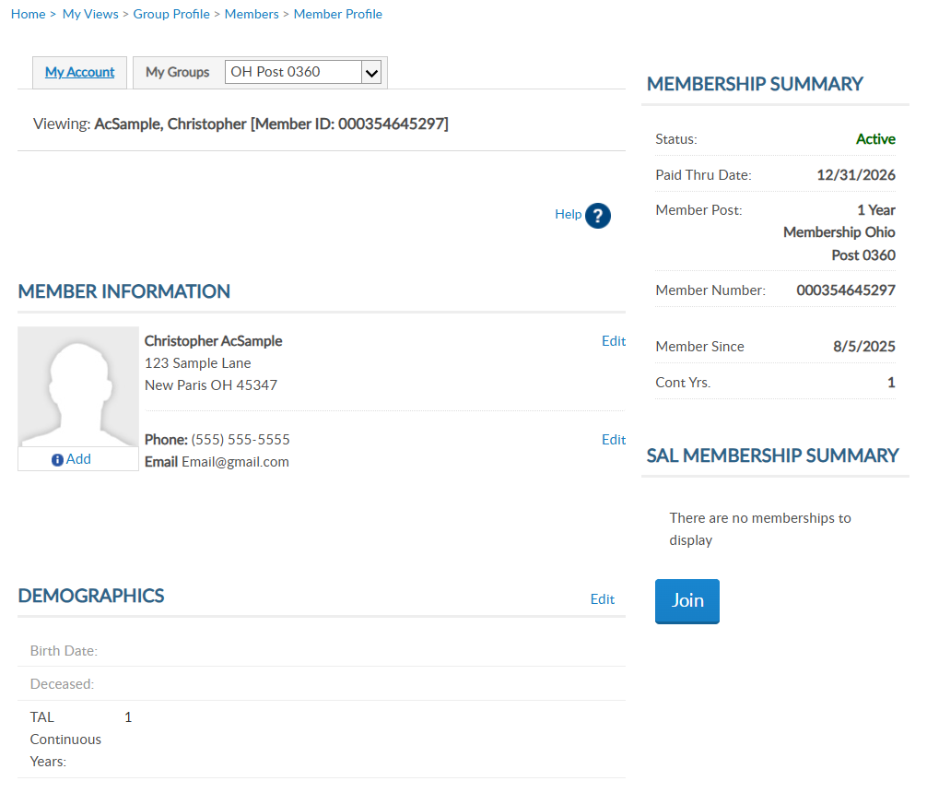

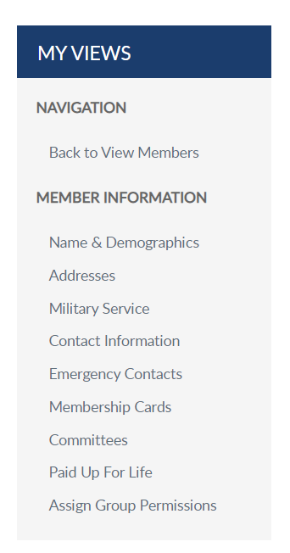
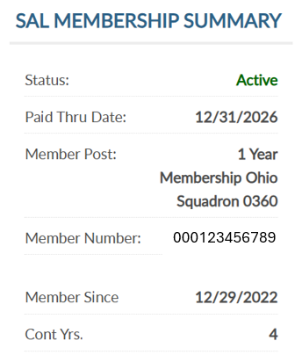

MEMBER PROFILE
Viewing: AcSample, Christopher [Member ID: 000123456789]
LGN and SAL details display.
Both memberships should have the same ID#.
000123456789
4
Notes:
Viewing a member displays the member’s name, ID number, contact information, demographics, and membership summaries. <1> For members of both The American Legion and Sons of the American Legion, both membership summaries are displayed. Summaries include status, paid through year, membership type, continuous years and member id number.
The membership ID number is the same for both memberships.

Slide 13
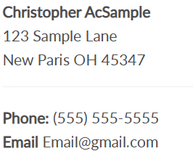
Address and Contact Information (phone/email)
C0NTACT INFORMATION
Viewing: AcSample, Christopher [Member ID: 000123456789]
000123456789
4
Notes:
Edit or add contact information by clicking the edit button in member information.

Slide 14
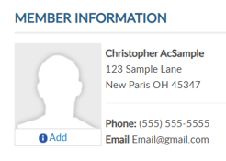
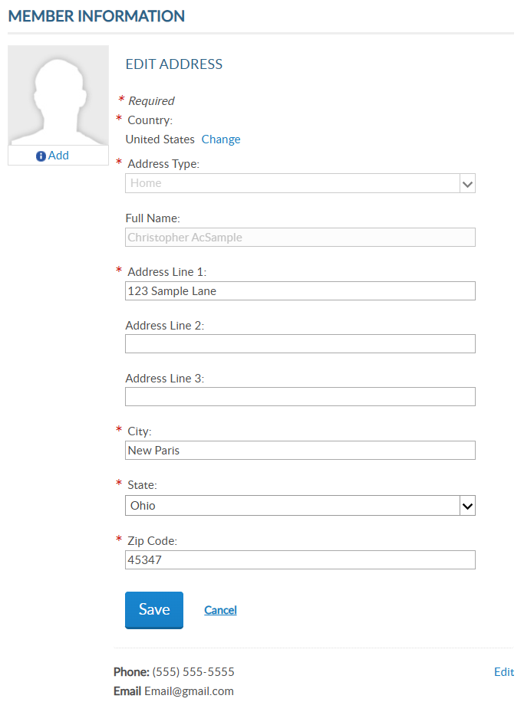

PRIMARY Address and Contact Information (phone/email)
C0NTACT INFORMATION
Notes:
Edit the primary mailing address, phone and email address using the edit links or links from the left menu. Save updates with each entry.

Slide 15
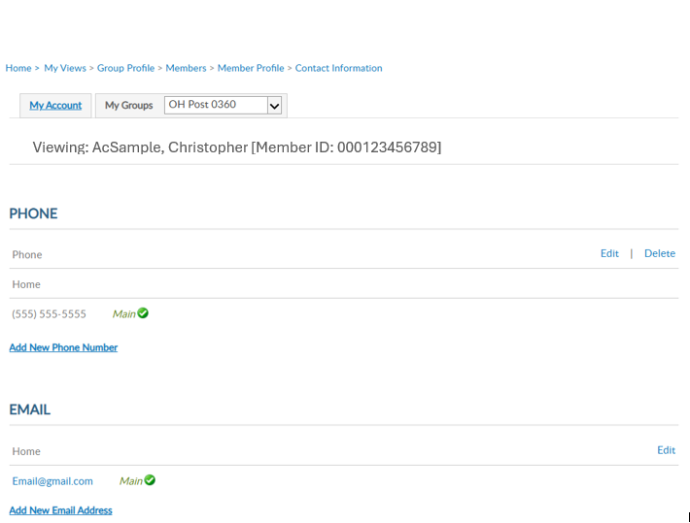
CONTACT INFORMATION
Notes:
Use, edit, delete or add update as needed. Members can have multiple emails and phone numbers. A total of 3 emails can be on a member’s record.
Updating the main email addresses updates the email associated with your myLegion account. All email communications for myLegion password and username are sent to the main address.
If one email is on file, no delete option will be available. An email must exist on your record to have a myLegion account. In the event you do want to delete your email address, contact National MyLegion support staff to delete.

Slide 16
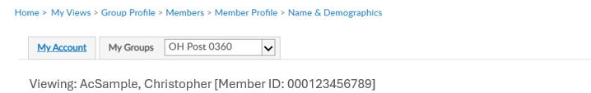
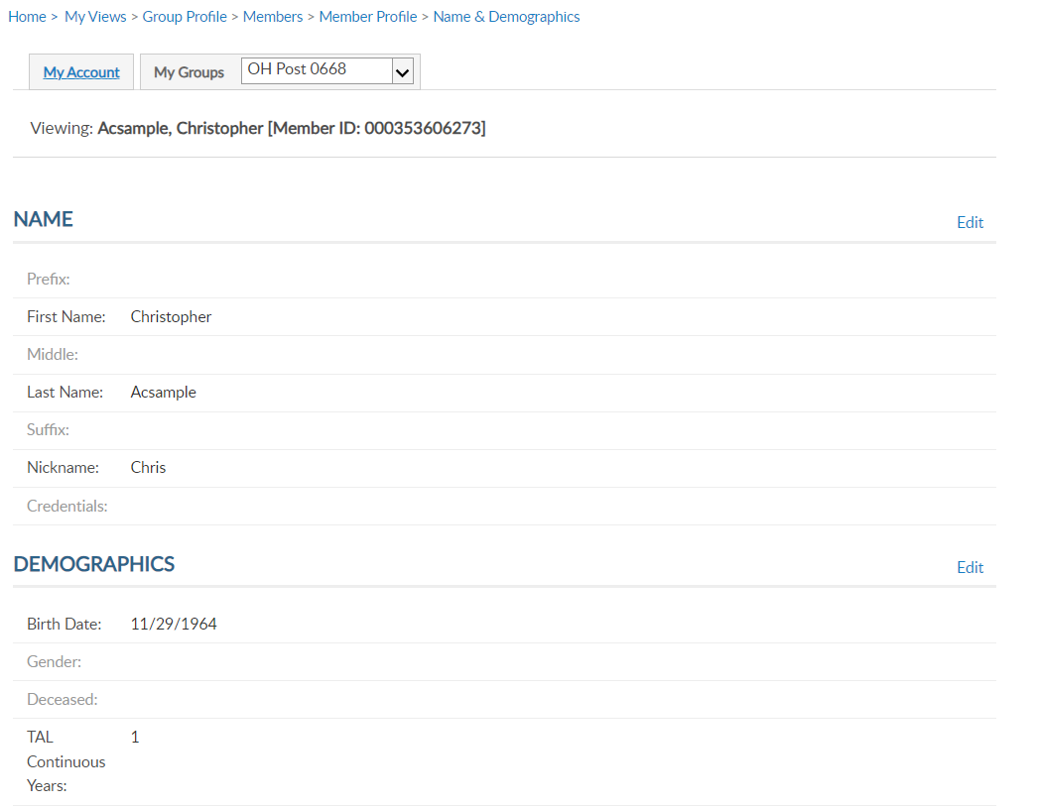
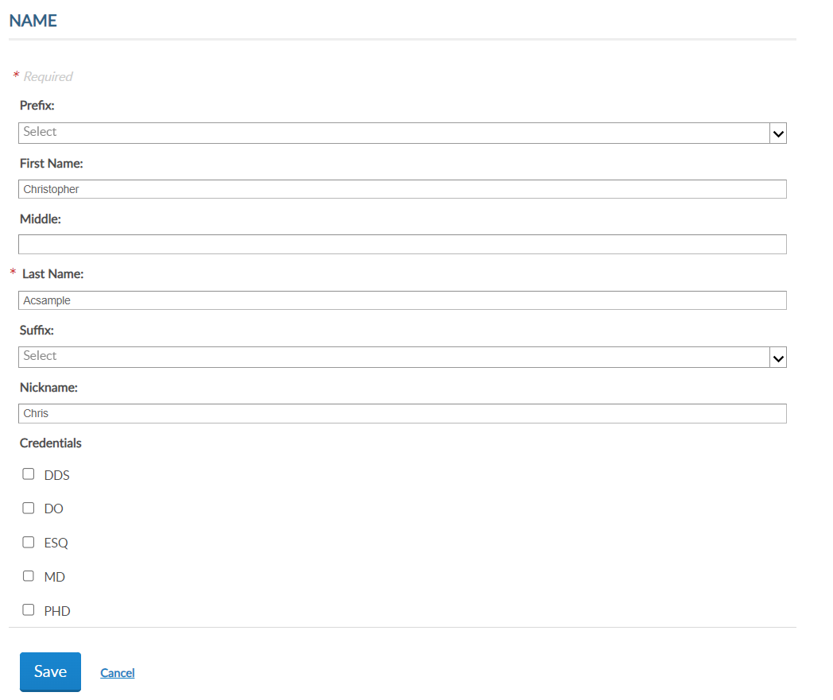
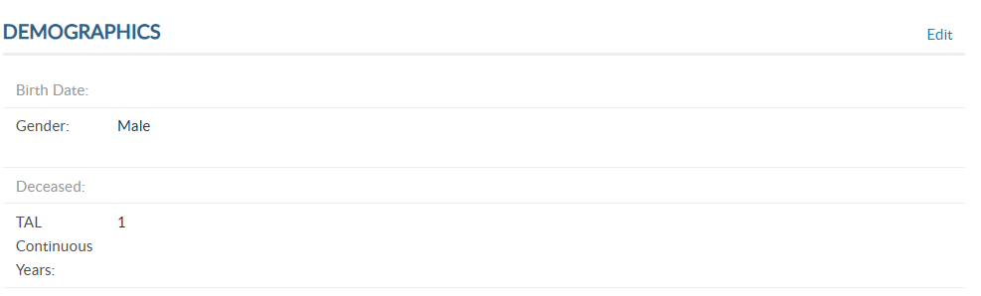
NAME & DEMOGRAPHICS
4
Notes:
Name and demographics has 2 sections, each with an edit button. <1> Use the top edit button to edit name. Always save when updates are made.

Slide 17
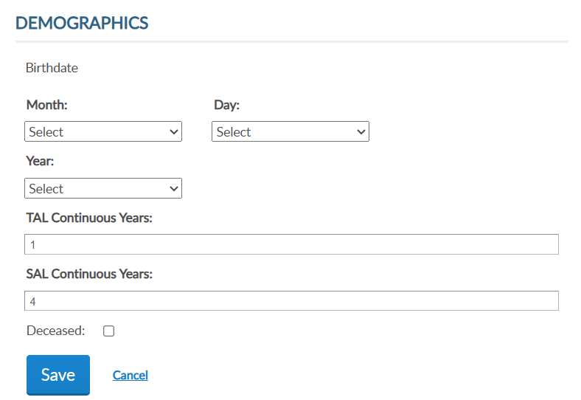
NAME & DEMOGRAPHICS
4
Notes:
To update date of birth, gender, continuous years and deceased status, click on the Edit button in the Demographics area. <1> Enter updates and save. Please note, you cannot remove deceased status through MyLegion. If a member is flagged as deceased in error, contact your department headquarters.

Slide 18
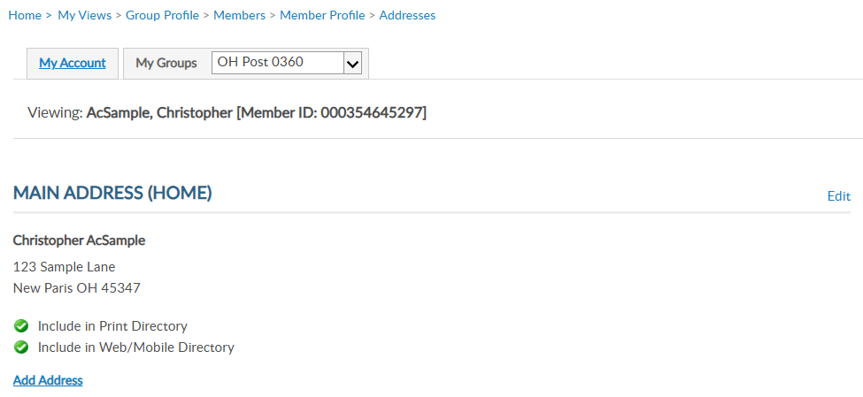
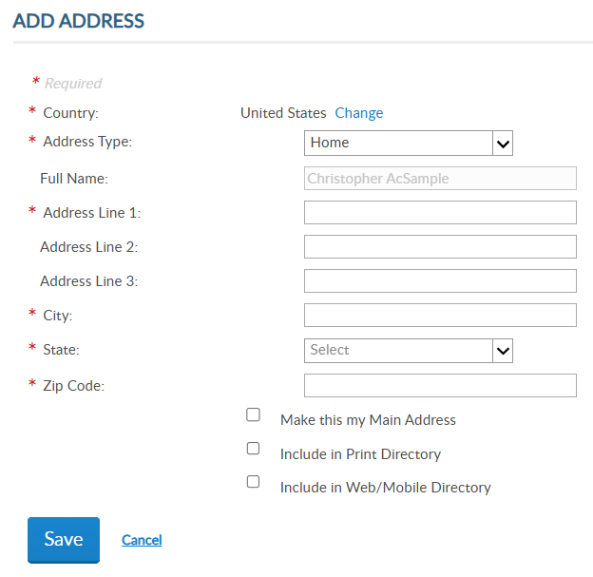
ADDRESSES
Viewing: AcSample, Christopher [Member ID: 000123456789]
Notes:
Addresses allow you to update existing addresses or add an additional address to the member’s record. Members are required to have one main, or primary, address. The primary address listed on a member record determines where the address communications are sent for renewal notices, campaigns, and membership information. The main address cannot be deleted.
Some members may need an additional address on file for mailing subscriptions, or committee and officer correspondence. To add an additional address, click Add Address. <1> Selecting “Make this my main address” will make this your primary mailing address. Enter address information and save.

Slide 19
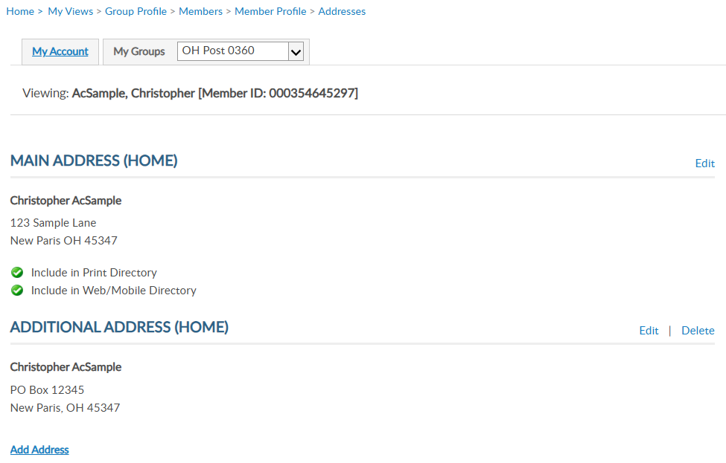
ADDRESSES
Viewing: AcSample, Christopher [Member ID: 000123456789]
1
2
Notes:
The member record now has 2 addresses on file. Notice deletion is now available. Delete only appears for alternate contact information.

Slide 20
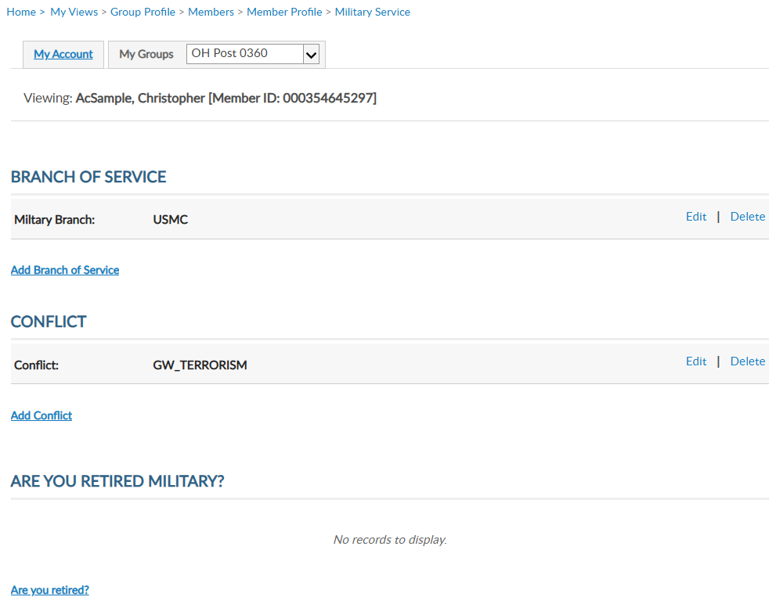
MILITARY SERVICE
Viewing: AcSample, Christopher [Member ID: 000123456789]
Notes:
Military Service includes branch of service, conflict and retirement information and applies to Legion membership.
MyLegion allows multiple selections to be stored on the member record. Use the links to Edit, Delete or Add branch of service and conflict.

Slide 21
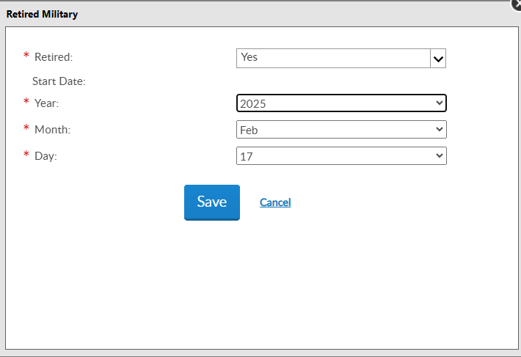
MILITARY SERVICE
Viewing: AcSample, Christopher [Member ID: 000123456789]
Notes:
You can also store retirement information. To add retirement information, click on the link Are you Retired? Enter the date and save.

Slide 22
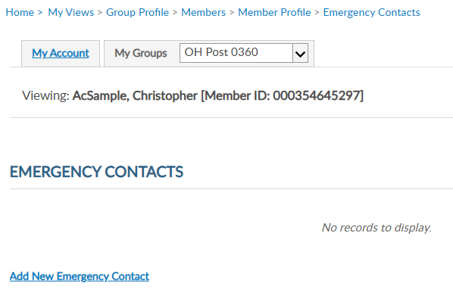
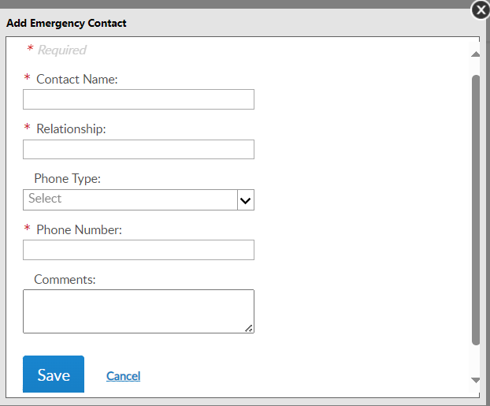
EMERGENCY CONTACTS
Viewing: AcSample, Christopher [Member ID: 000123456789]
Notes:
Store emergency contact information in case of an emergency. Enter emergency contact name, relationship, phone number, any comments and save. - This information can be seen by local, department and department leadership in case of an emergency if the member attends events and conventions or local activity of The American Legion or Sons of The American Legion.

Slide 23
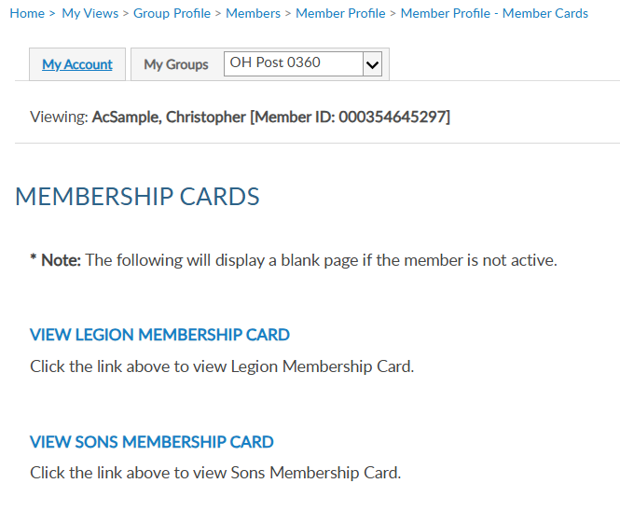
MEMBERSHIP CARDS
Viewing: AcSample, Christopher [Member ID: 000123456789]
Notes:
Print a membership card for a member. Click the link to view membership card. <1> Only current membership cards are available. This page will display as blank if membership is not active. Click on the link to view and print a card. Members who have both Legion and Sons of the American Legion members will have 2 options.

Slide 24

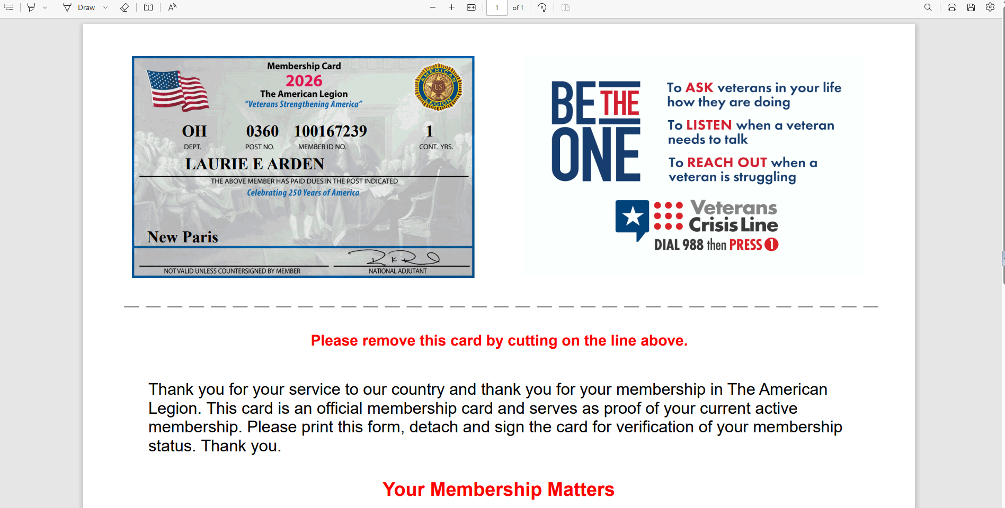
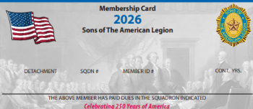
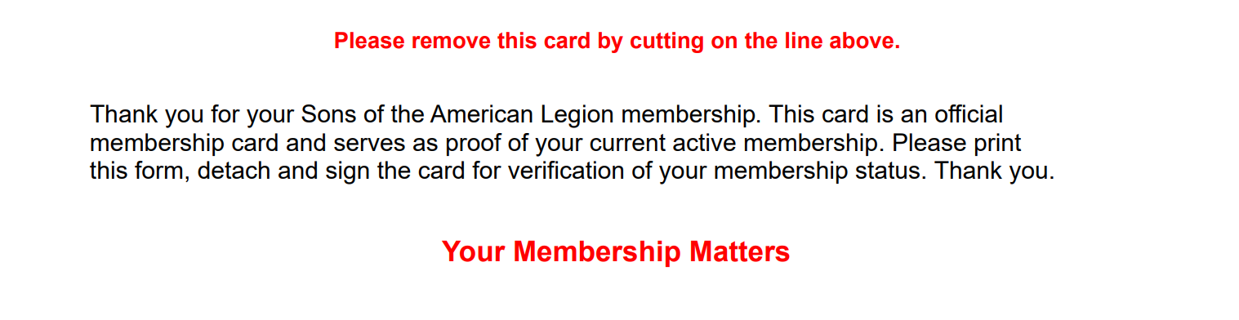
MEMBERSHIP CARDS
CHRISTOPHER ACSAMPLE
OH 0360 123456789
1
Notes:
The card is available to print or save from your web browser. A pdf document will open in your browser to save or print.<1>

Slide 25
MEMBERSHIP CARDS
123456789
CHRISTOPHER ACSAMPLE
Notes:
You can also print a Legion card for current Legion membership.

Slide 26
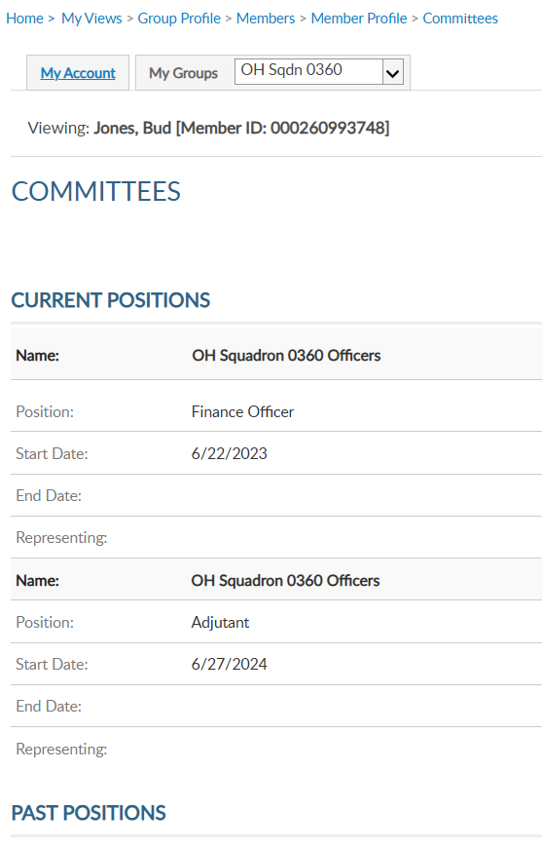
COMMITTEES
Viewing: AcSample, Christopher [Member ID: 000123456789]
Notes:
Committees lists offices held that are recorded on National’s membership system. It will display current and past positions.
This area is view only and reflects officers reported to National HQs. Officer updates are reported through your department using a squadron officers certification form. Incorrect committee information should be reported to your department.

Slide 27
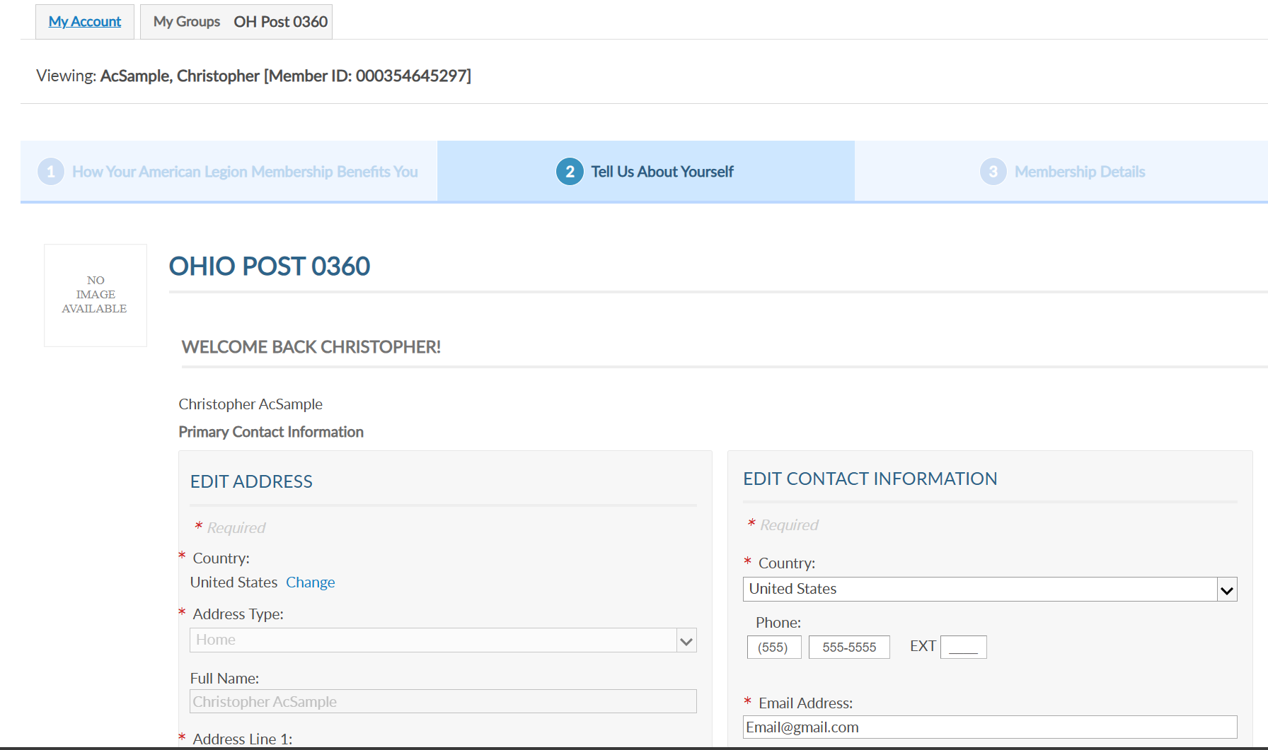
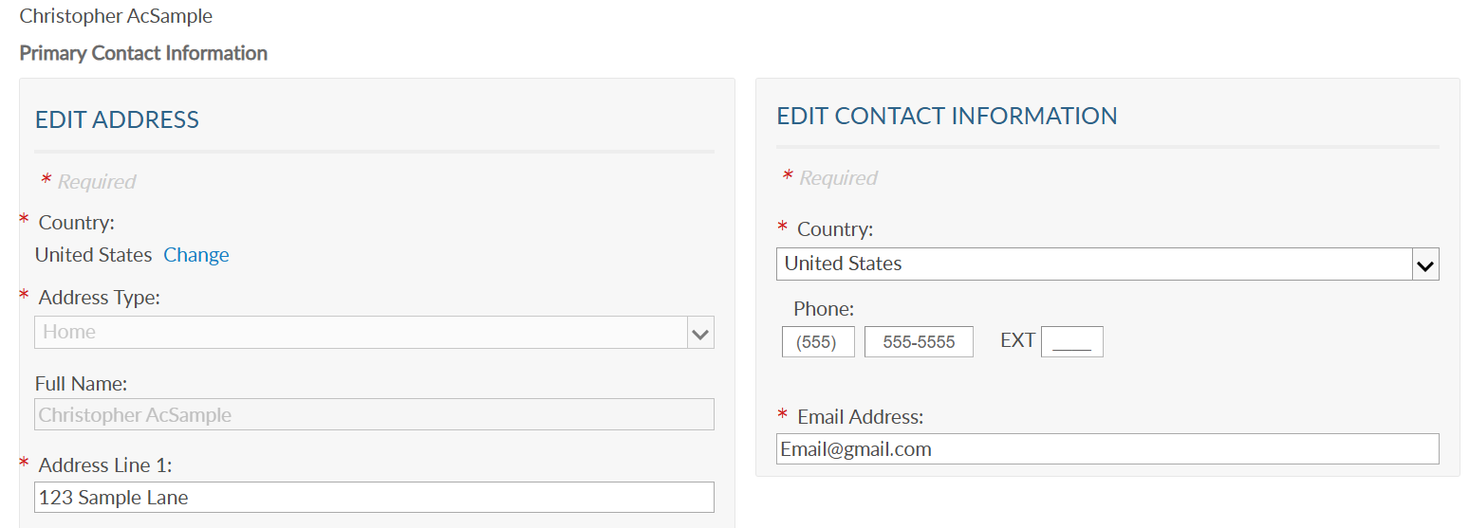
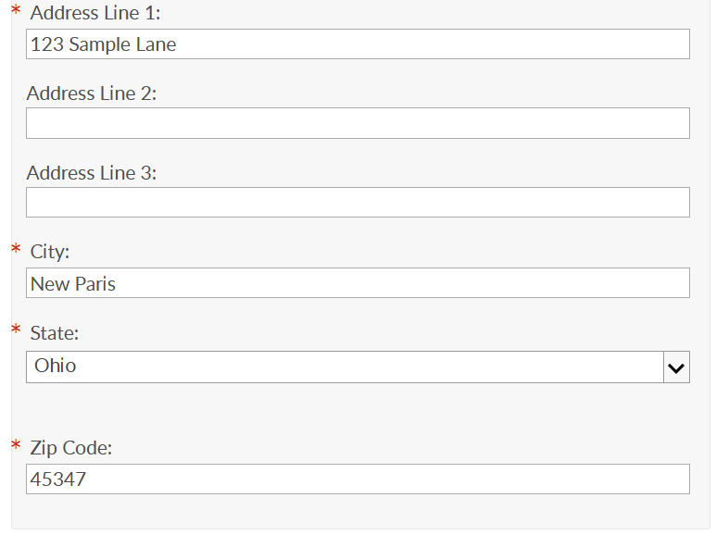
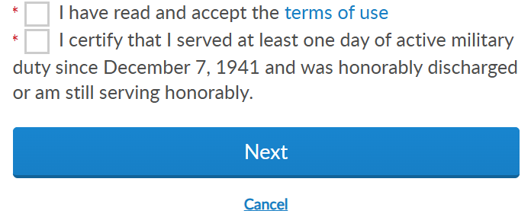
PAID UP FOR LIFE
LEGION MEMBERS ONLY
Notes:
Paid up for life allows you to assist members with the online application. Paid Up For Life is a national program for Legion members only. Son’s members are not eligible for PUFL membership.

Slide 28
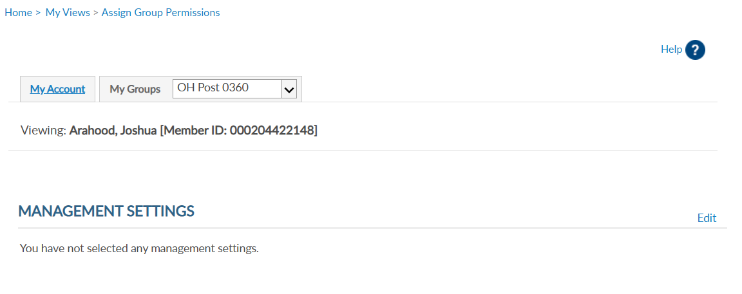

ASSIGN GROUP PERMISSIONS
Viewing: AcSample, Christopher [Member ID: 000123456789]
Notes:
Assigning group permissions should be used with caution. This tool allows adjutants and commanders to grant access to squadron membership to other members.
To add, delete or edit management settings, click edit. <1>

Slide 29
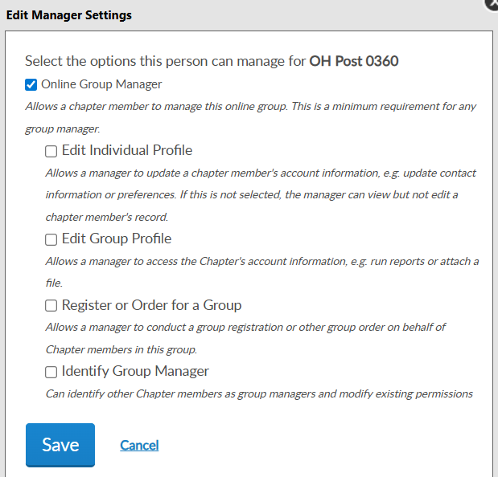
ASSIGN GROUP PERMISSIONS
Select the options this person can manage for OH Squadron 0360
Online Group Manager
Minimum Requirement
View and print member list.
Quick link to email address.
Notes:
To provide the same access adjutants and commanders have, begin by selecting
Online Group Manager. This is the minimum permission requirement. It provides access to view members and a quick link to member email addresses. Selecting this option only results in view only and records cannot be updated.

Slide 30
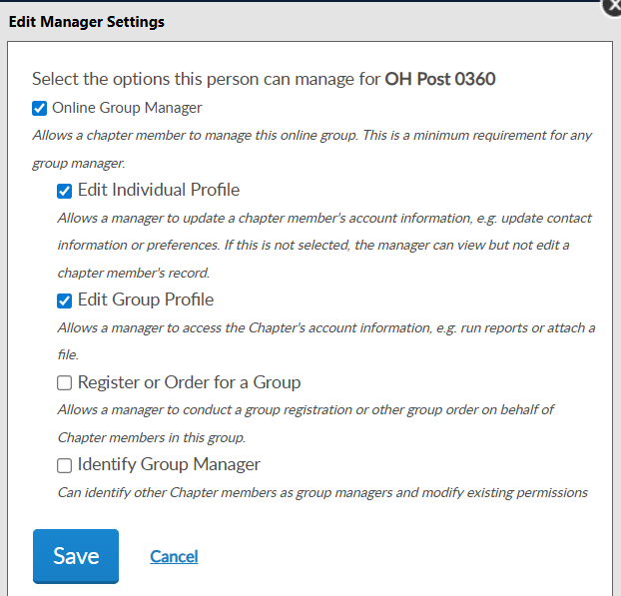
ASSIGN GROUP PERMISSIONS
Select the options this person can manage for OH Squadron 0360
Edit Individual Profile
Edit member information
Edit Group Profile
Online Membership Tools: View Members, Global Member Lookup, Group Attributes, Reports/Labels, and Officer Materials.
Notes:
Check Edit Individual Profile to grant authority to add and edit member information. <1> Edit Group Profile provides access to View Members, Global Member Search, Group Attributes. Reports, Letters, Labels and Officer Materials.

Slide 31
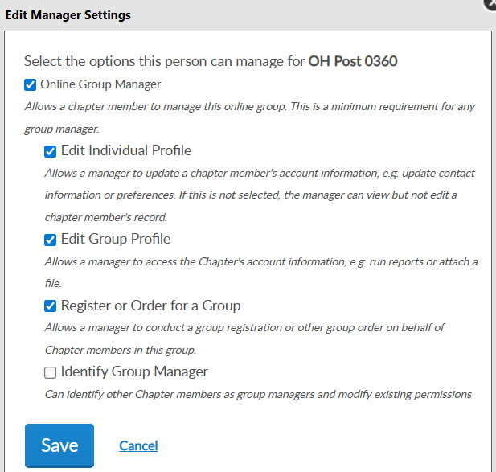
ASSIGN GROUP PERMISSIONS
Select the options this person can manage for OH Squadron 0360
Register or Order for a Group
Allows online membership processing, Add/Modify Transmittal.
Identity Group Manager
ADJUTANTS AND COMMANDERS ONLY.
Notes:
Register or Order for a group is now the setting to allow other members to process membership online using Add/Modify transmittal. This permission allows the member to renew, transfer and add new members as well as update payment information.
<1> The last setting is only available to adjutants and commanders. This setting allows the member to provide management settings for other members.
After the desired management settings are assigned, click on the Save button.

Slide 32
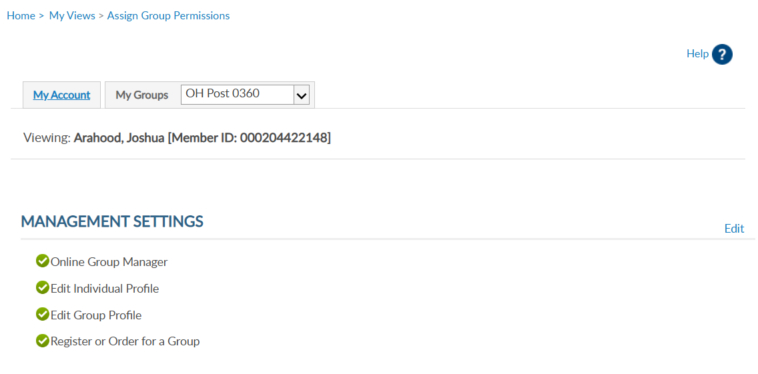
ASSIGN GROUP PERMISSIONS
Viewing: AcSample, Christopher [Member ID: 000123456789]
* Monitor access using MyLegion Access report.
* Contact department headquarters to add end date.
Notes:
Permissions added will display. The next time the member logs into their myLegion account, they will have access group membership.
<1> No end date is set when applying these permissions. Permissions can be removed by returning to Edit and unchecking the selections. It is important to keep track of anyone given permission to others. It is recommended to contact department headquarters or myLegion support to place an end date on permissions. You can monitor who has group permissions using the MyLegion Access report.
<2> Select back to view members to search for more names or select Group Profile to return to the group home page.

Slide 33

myLegion allows you to email a single member or group of members.
EMAIL MEMBERS
Outlook imposes several email restrictions, including sending limits, attachment size limits, and message delivery restrictions, which can impact your email communications.
Notes:
myLegion allows you to email a single member or group or members. The default browser for emailing through myLegion is Microsoft Outlook.
Outlook imposes several email restrictions, including sending limits, attachment size limits, and message delivery restrictions, which can impact your email communications.

Slide 34
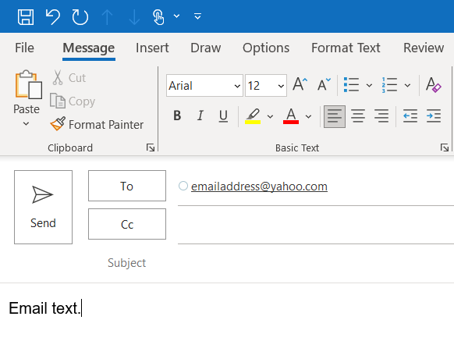
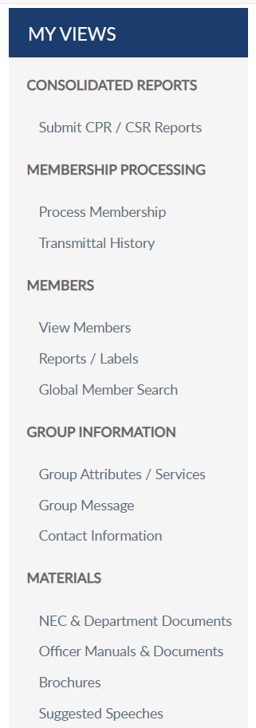
EMAIL SINGLE MEMBER
Member ID | Last, First | Sons of American Legion OH Squadron 0360 | 1 Year Mbrship | Address |  | email address Phone | Unknown | Unknown | 5 | 2025 | Expired
Member ID | Last, First | Sons of American Legion OH Squadron 0360 | PUFL renewal | Address |  | Phone |  |  | 49 | 2026 | Active
Member ID | Last, First | Sons of American Legion OH Squadron 0360 | 1 Year Mbrship | Address |  | email address Phone |  |  | 20 | 2026 | Active
Notes:
<1> To email and individual member, search them and click on the email hyperlink. <2> This opens your email browser to write and send an email.
The default email browser is Microsoft Outlook. If you are using another browser such as Gmail or yahoo, it will be required to set your browser-based email default preference.

Slide 35

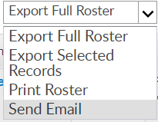



Email a group of members.
Select “View All”, filter data, check list of names and “Send Email”.
EMAIL GROUP OF MEMBERS
Member ID | Last, First | Sons of American Legion OH Squadron 0360 | 1 Year Mbrship | Address |  | email address Phone | UNKNOWN | UNKNOWN | 5 | 2025 | Expired
Member ID | Last, First | Sons of American Legion OH Squadron 0360 | 1 Year Mbrship | Address |  | Phone |  |  | 49 | 2026 | Active
Member ID | Last, First | Sons of American Legion OH Squadron 0360 | 1 Year Mbrship | Address |  | email address Phone | USA | OTHER | 20 | 2026 | Active
Member ID | Last, First | Sons of American Legion OH Squadron 0360 | 1 Year Mbrship | Address | Y |  |  |  | 1 | 2026 | Active
Notes:
Email a group of members by first selecting the records. The search fields allow you to filter the data. Search for the members to email. <1> Click View All. <2> Check all names in the list by clicking the checkbox in the title row. <3>Using the Actions menu, choose Send Email and click Go.

Slide 36
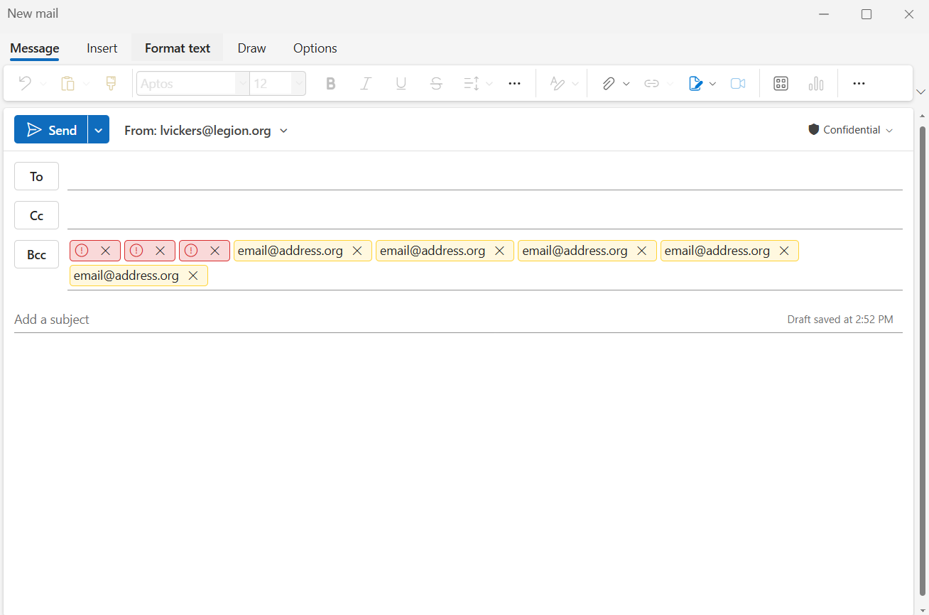
Group Email
Notes:
MS Outlook opens with recipients in BCC.

Slide 37
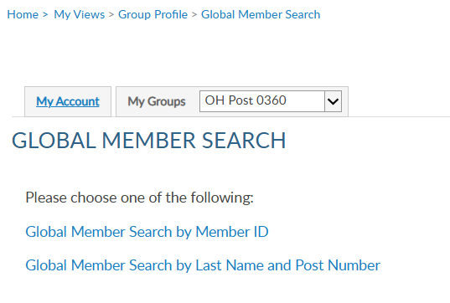

IMPORTANT INFO
Notes:
Global member search allows you to view members outside of your group. Two options are provided.
<1>Search by ID allows you to enter a Legion or Son of The American Legion membership number to view limited information. <2>Enter the ID number, click View Report to view name, member type, paid post or squadron, and last paid year.

Slide 38

IMPORTANT INFO
Notes:
Search by last name and number requires both pieces of information. <1>Click View Report to view.<2>

Slide 39

Notes:
Online help is available from the top Menu “Find Help”.
Step by step instructions, videos and training presentations will assist with how to manage groups in MyLegion.

Slide 40

Online Help
Notes:
Step by step instructions, videos and training presentations will assist with how to manage groups in MyLegion. My Groups instructions include managing membership, online, membership processing, reports and all other administrative tasks.

Slide 41
MYLEGION SUPPORT
MyLegion@legion.org
833.253.9995
Monday – Friday
8:00am – 4:30pm
(Eastern)
The American Legion National HQs
5745 Lee Road
Indianapolis, IN 46216
Contact your MyLegion support team to assist with any questions or tools on your MyLegion account.
Notes:
Contact your myLegion support team to assist with questions and tools for MyLegion. Email mylegion@legion.org or call 833-253-9995 Monday through Friday.

